Slide 1
Easy Cabs
A web application for calculating dynamic price of Uber and Lyft cabs
Nayantara Mohan
Rohit Lokwani
Shubha C Palachanda
Github repository
Notes:
S

Slide 2
Introduction
Uber and Lyft account for the major market capitalization for offering cab services on an app.
But these prices are not constant like public transportation. They are greatly affected by the demand and supply of rides at a given time.
So what exactly drives this demand? Some of the factors include weather changes, rush hours and location.
Domain
Machine Learning, Software Design, UI/UX
Goals
To understand the software design, code and use of APIs for large scale systems.
Learn software Design for scalable systems
Study, design and implement a well thought out ML application following software design principles like separation of concerns, abstraction and refactoring.
Notes:
S

Slide 3
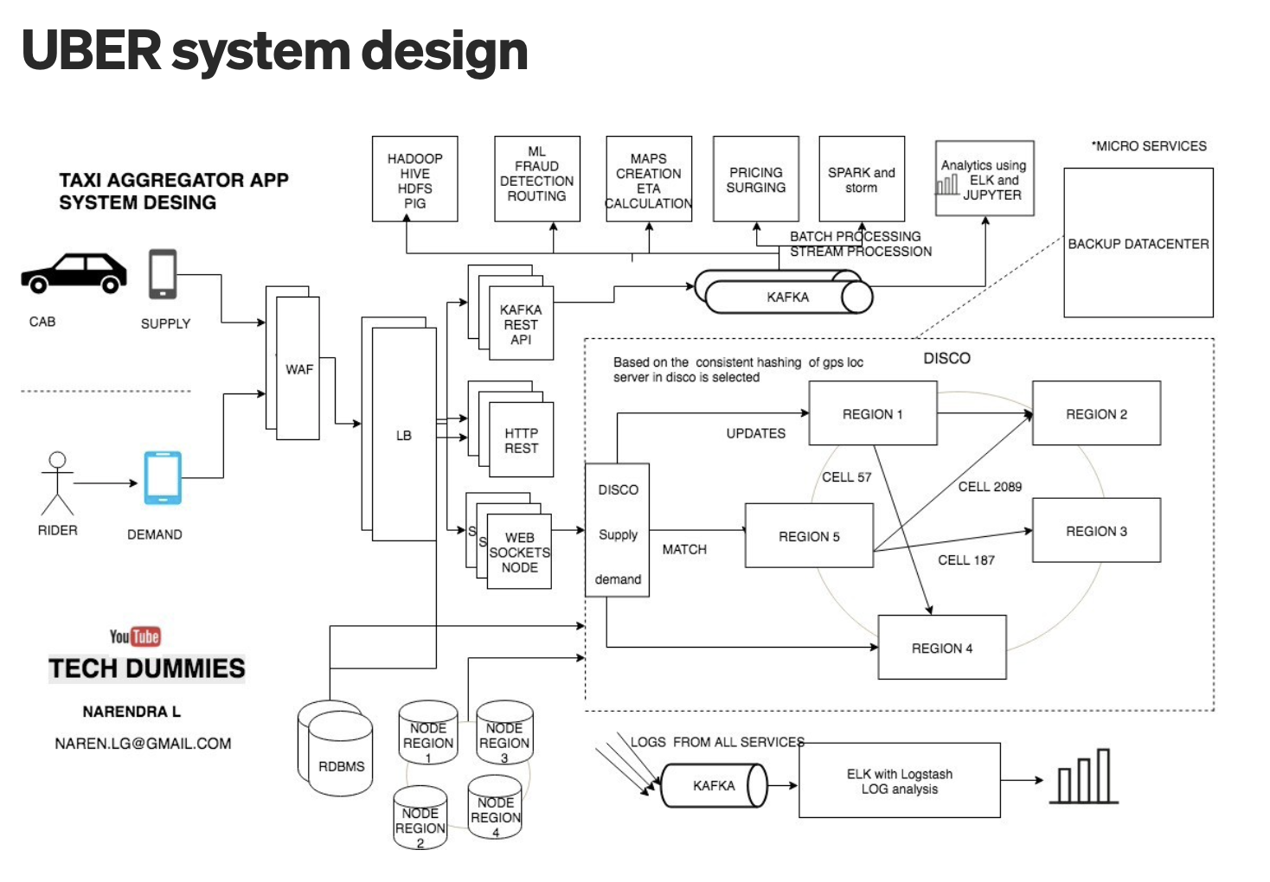
Background
Parameters like Rush hour, traffic, weather conditions, source and destination was inspired based on the background research conducted.
ML model parameters considered referring to Uber’s blog:
https://www.uber.com/en-GB/blog/uber-dynamic-pricing/
Notes:
S

Slide 4
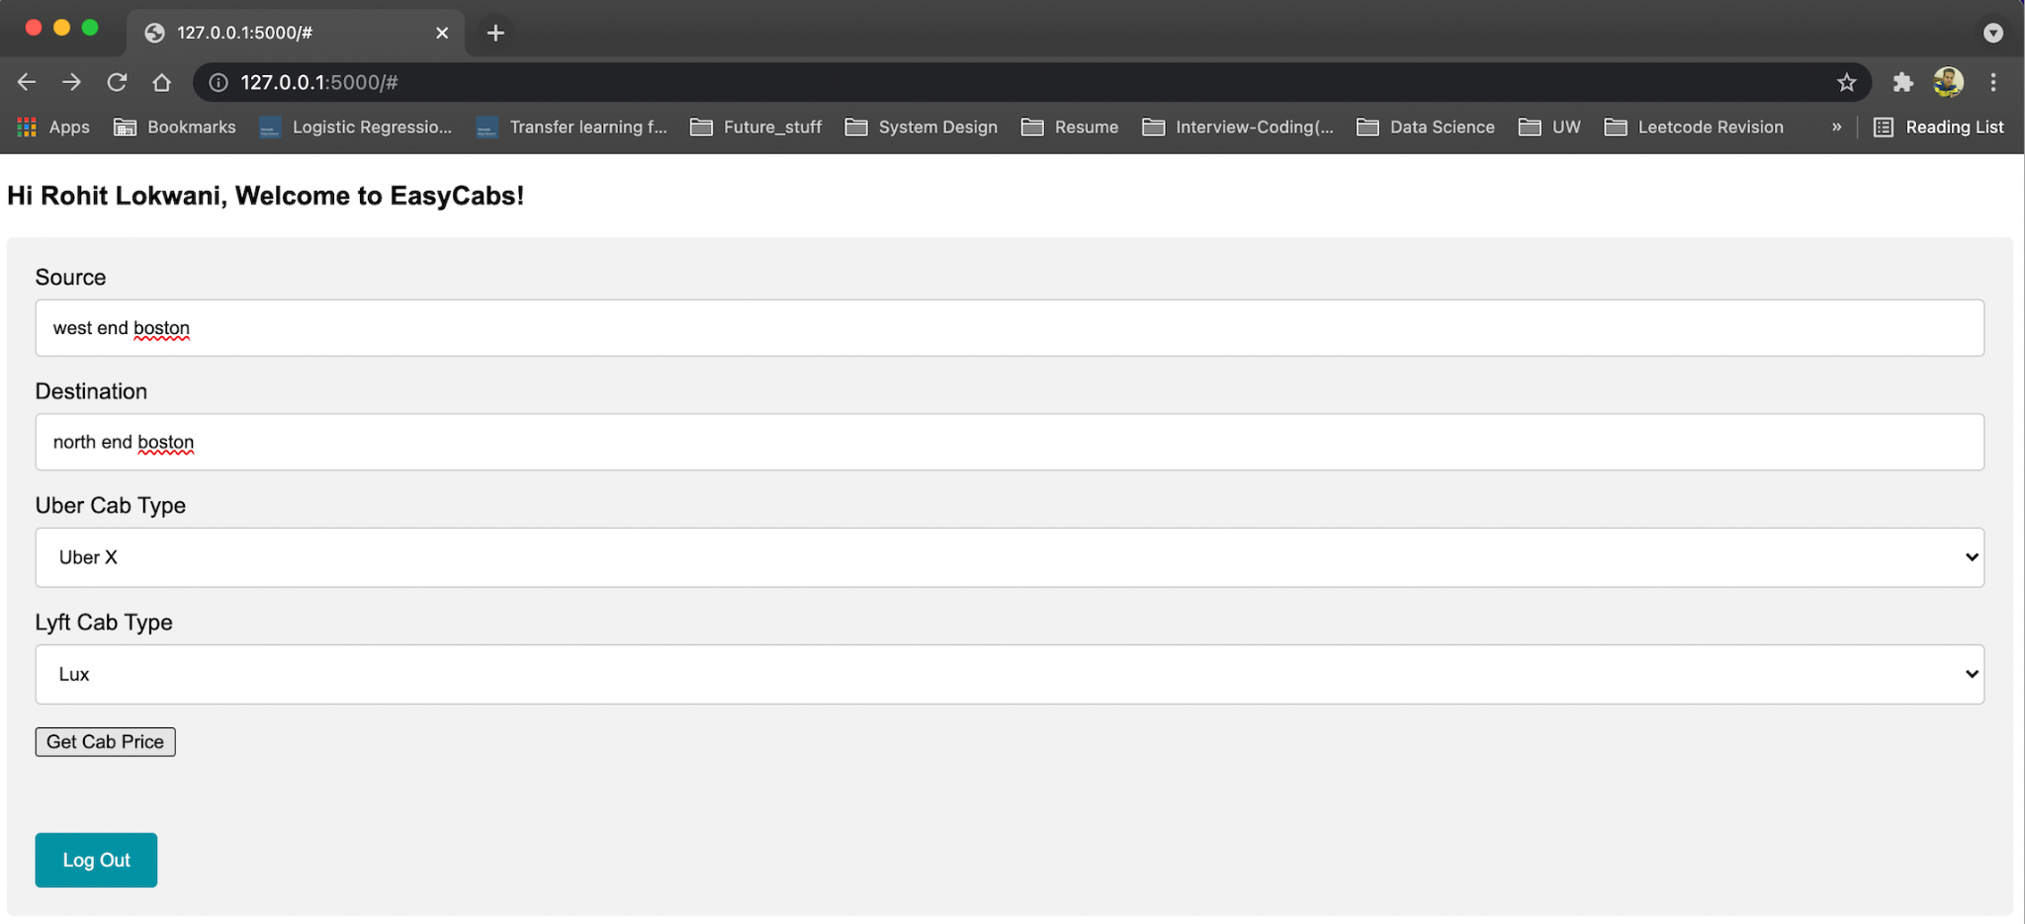
Problem Statement
Develop a thoughtfully designed ML-based web application which compares dynamic price of Uber and Lyft cabs depending on user requirements
prototype output
Notes:
S

Slide 5
Data & Limitations
Uber & Lyft Cab Prices Dataset | Kaggle
Features
Limitations
Dataset restricted to areas within Boston, MA
cab_type : Uber or Lyft.
clouds : presence or absence of clouds.
destination : name of the destination in words.
humidity : humidity in percentage.
location : location of the place where the weather is recorded.
pressure : atmospheric pressure in millibar.
price : price estimate for the ride in USD.
rain : rain in inches for the last hour.
name : type of the car specified, eg. X, XL.
source : name of the source in words.
surge_multiplier : 5 unique values mentioned.
temp : temperature in Fahrenheit.
time_stamp : start of the cab journey in epoch units.
wind : wind speed in miles per hour.
Notes:
S

Slide 6
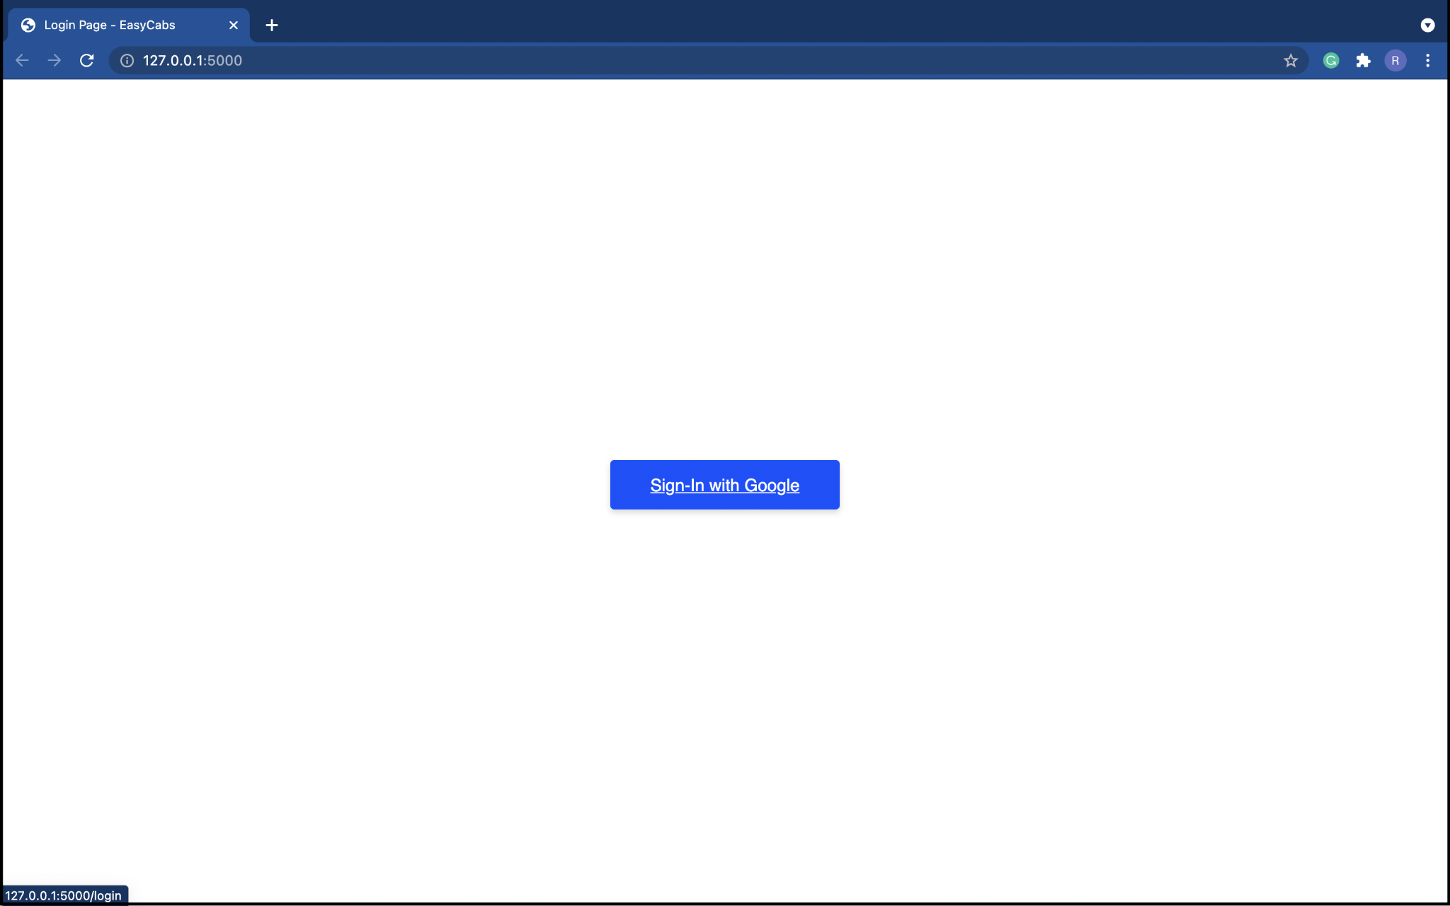
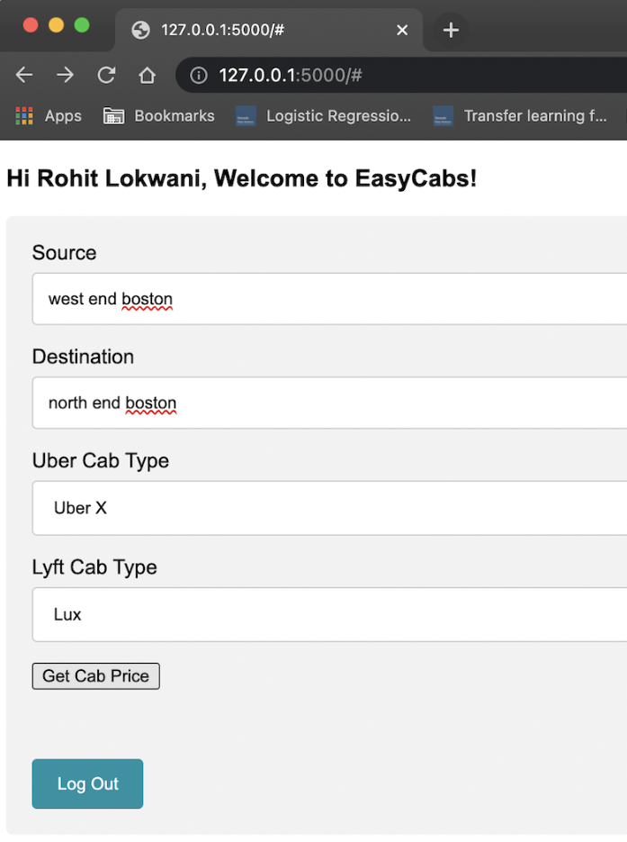
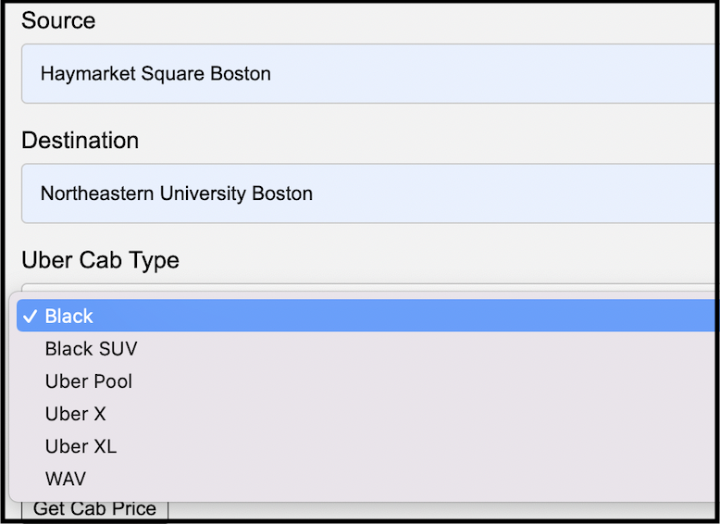
User Interaction
This application helps the user in choosing a cab from Uber or Lyft as per the dynamic cost output generated.
User input requirements: -
Enters source and destination.
Provides cab types for uber and lyft.
Notes:
N

Slide 7
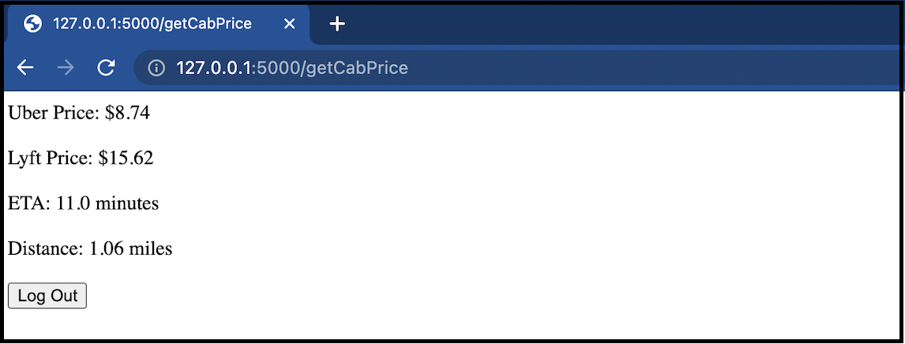
User Interaction
Program: Calculates the surge and price prediction
Output: Returns result as follows
Notes:
N

Slide 8

High Level Design
Google Maps API
Output
Web App
Weather API
Uber & Lyft Pricing API
Login API
Run predictions
Retrain every friday
Login unsuccessful, try again
Database
Feedback Loop Microservice
Retrain model 1
Retrain model 2
Update in the flask app above
Notes:
R

Slide 9
Low-Level System Design (Component Design)
Component 3
(Surge calculation- Random forest Classification model)
Component 1 (Oauth API)
Component 2 (Get cab price and other API calls)
User
Component 4
(Dynamic pricing model -Linear Regression model inference)
Component 6
(Feedback loop cron job)
Component 7 (Database)
Component 5 (Output)
Notes:
R

Slide 10
Demo
Notes:
R

Slide 11
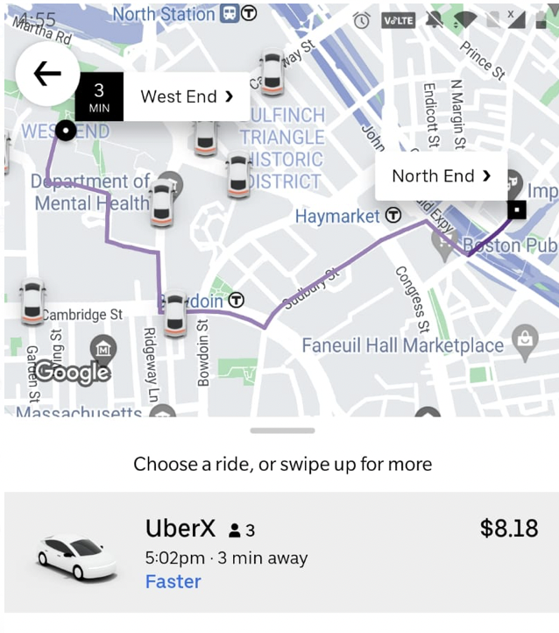
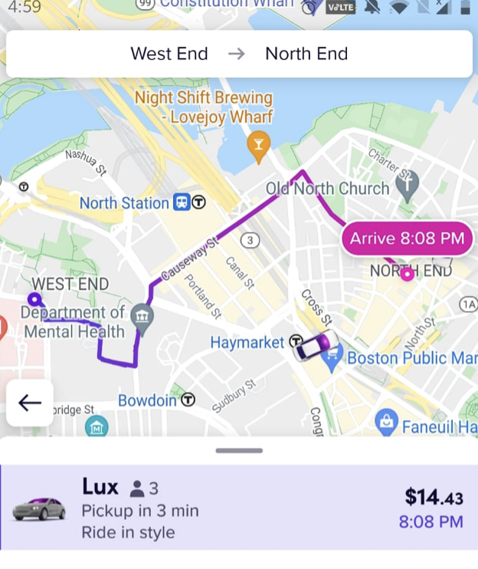



How our Models work compared to Uber and Lyft
Uber X and Lyft Lux selected which gave the following price prediction
Uber X and Lyft Lux selected at the same time.
 | Real App | Easy Cabs
Uber X | $8.18 | $8.74
Lyft Lux | $14.43 | $15.62
Notes:
N

Slide 12
Lessons Learned
Importance of code readability
Working on collaborative projects (Used excel for task management)
Streamlining development using version control, unit testing and Continuous Integration
Writing scalable software
Why some of the following are important and we incorporated them:
Code extensibility
Separation of concerns
Abstraction
Developing APIs as deep modules with minimal interface
Notes:
N

Slide 13
Future work
Add database
Add Deployment (Development/application Server)
Add logging and monitoring mechanism
Get Uber and Lyft API server tokens to make the feedback loop fully functional
Notes:
S

Slide 14
Thank You!

